Slide 1

Smart Decide

Slide 2
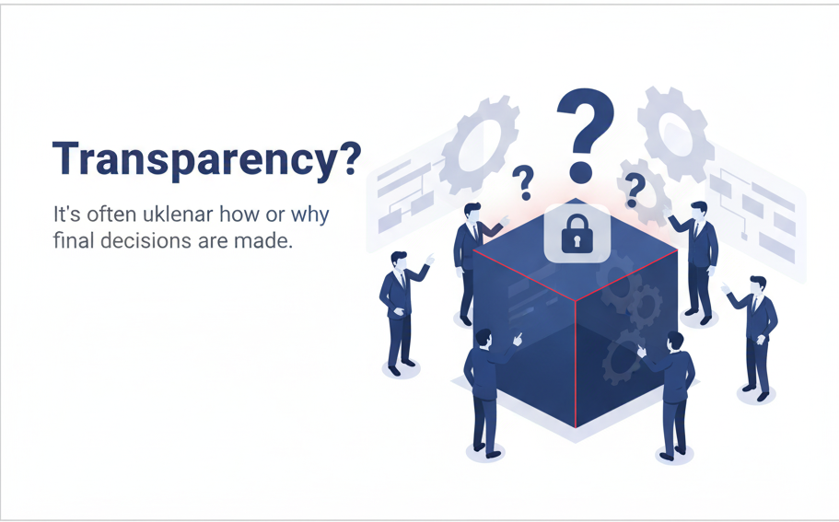
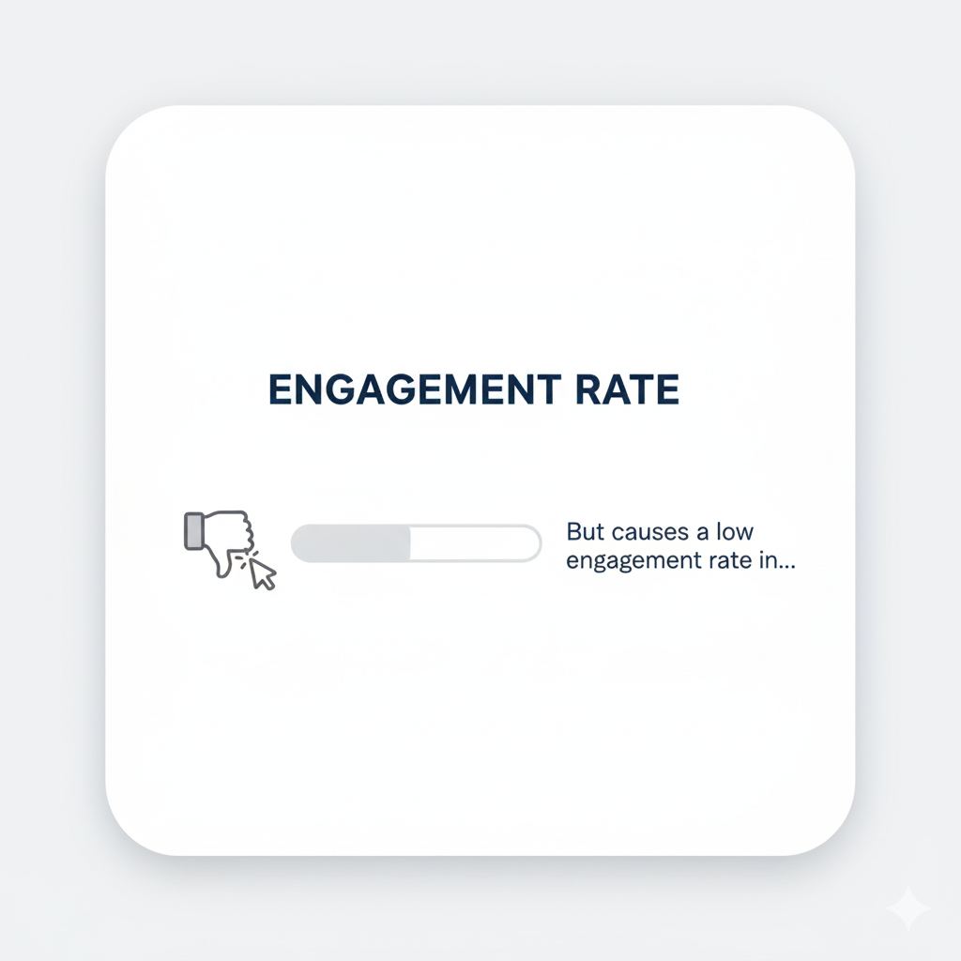

Problem Statement
01
Transparency ?
It’s often unclear how or why final decisions are made.
Many participants feel their input has little impact.
Engagement?
02
03
Accountability?
There’s no trusted record to verify the process or results.

Slide 3
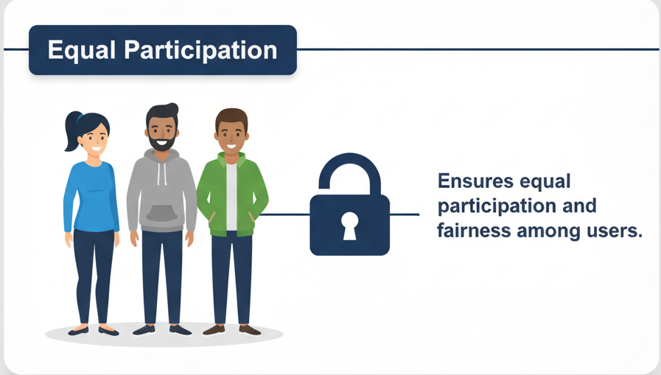
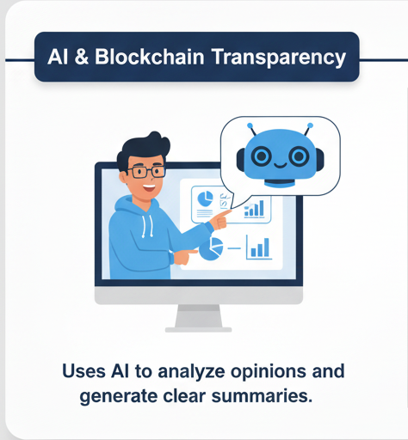
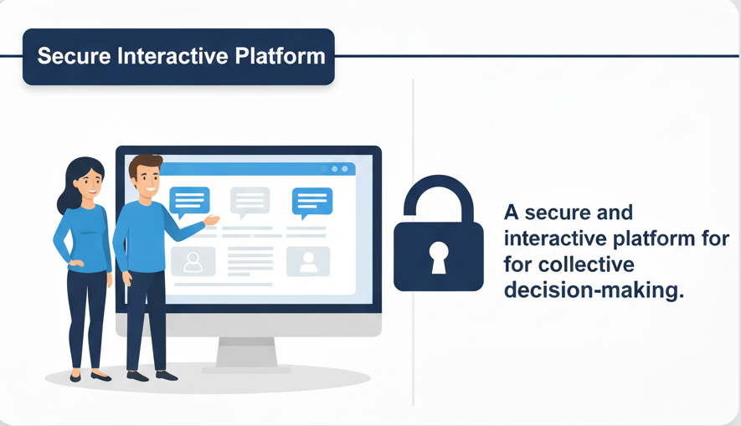
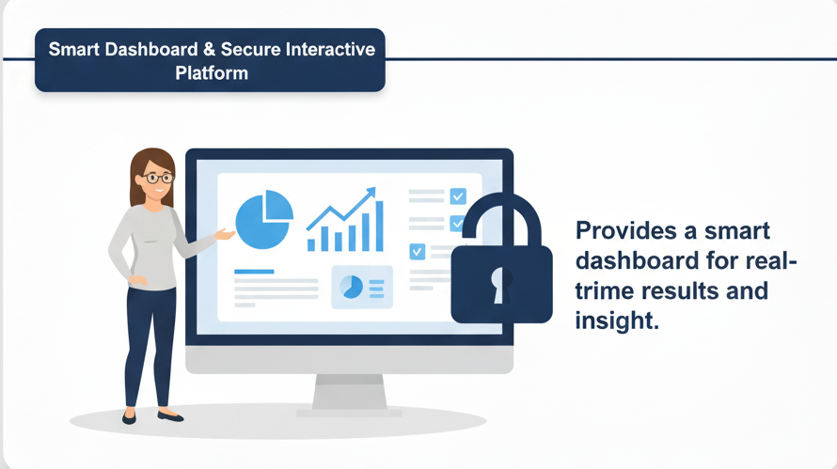
Our Solution

Slide 4
Objectives
Transparent & Inclusive Decision-Making
Collaborative Discussion Spaces
AI-Powered Insights
.
Trust & Security Through Blockchain
.

Slide 5
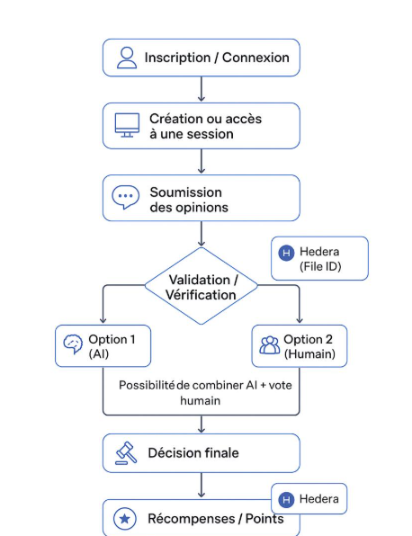
Scenario

Slide 6
Business model
Transparent decision-making.
AI-powered analysis
Immutable records on Hedera blockchain
App development & maintenance
Voting algorithms, data analysis & blockchain
Marketing & user awareness campaig
Subscription plans (monthly/annual).
Premium analytics & NFT certificates.
API licensing for partners.
Revenue Streams

Slide 7
Conclusion
SmartDecide is a simple, secure, and interactive solution for transparent, fair, and efficient group decision-making.

